Slide 1
BADMINTON SERVER VER 1.0
USER GUIDE
OptiPace Technologies Private Limited

Slide 2
Version | Date | Edited By | Description
1.0.01 | 04-06-2020 | Megha M | Initial Release(Draft copy)
1.0.02 | 23-06-2020 | Megha M | Updated GUI

Slide 3
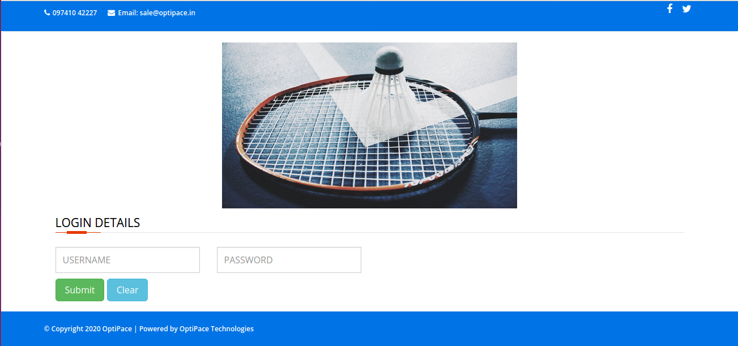
Login Page

Slide 4
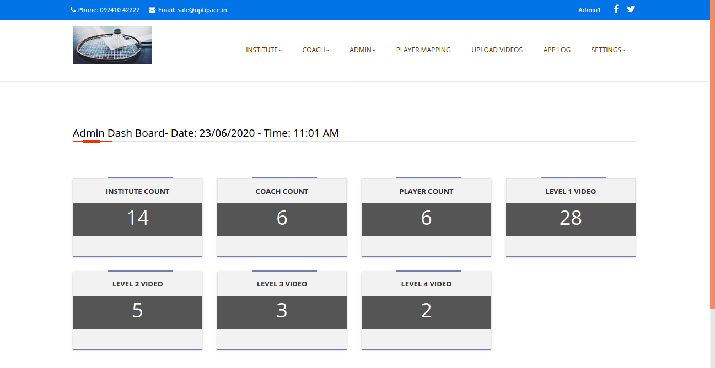
After Successful Login: Redirects to Dashboard

Slide 5
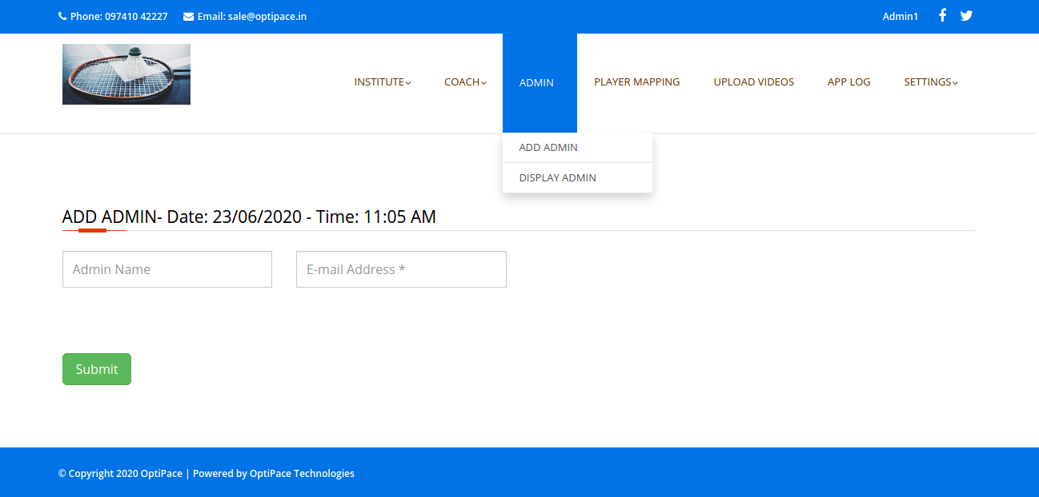
Admin Registration

Slide 6
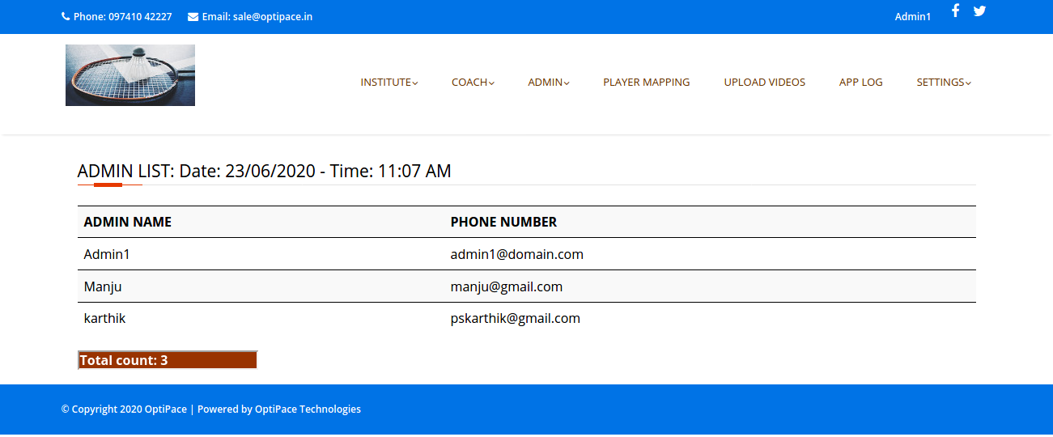
LIST OF ADMIN is viewed by clicking on DISPLAY ADMIN

Slide 7
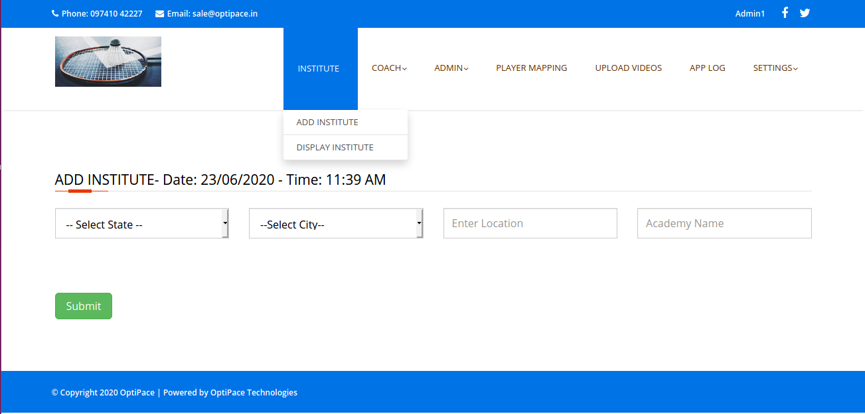
ADD NEW INSTITUTE

Slide 8
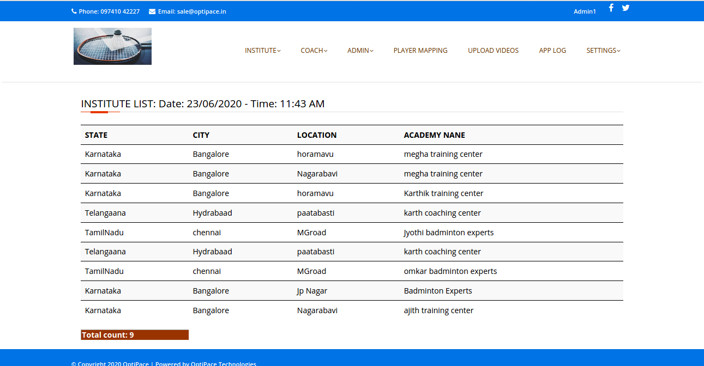
Display Institute

Slide 9
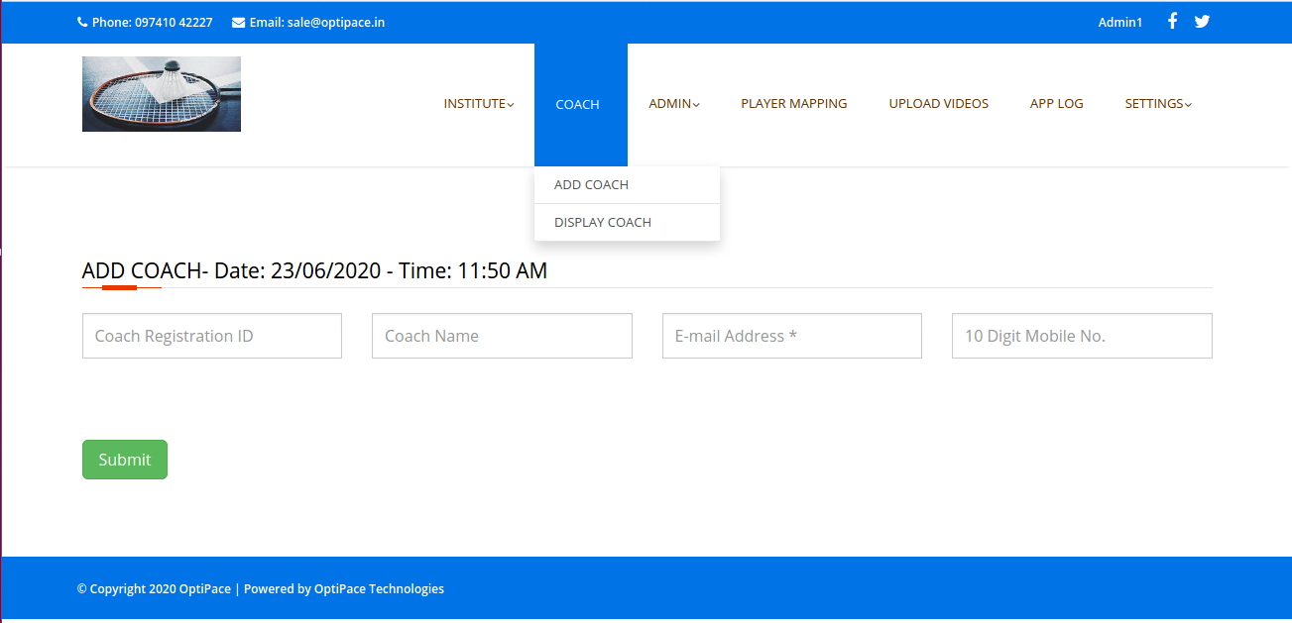
Add Coach

Slide 10
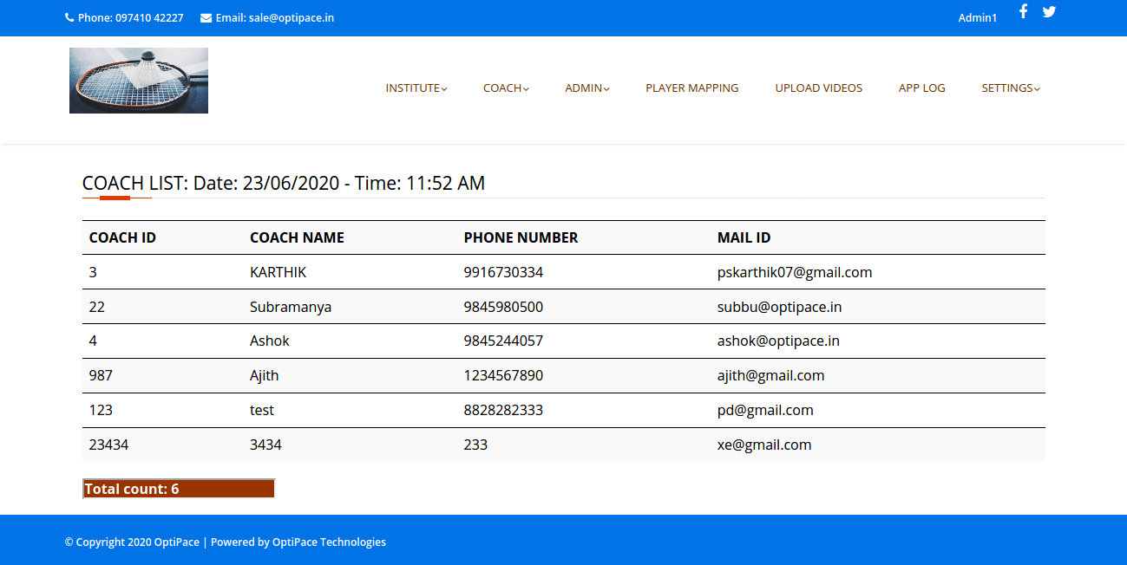
Display Coach

Slide 11
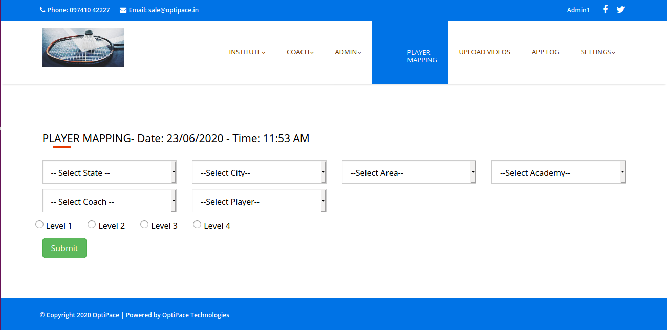
Registered Player mapping to Coach and setting level

Slide 12
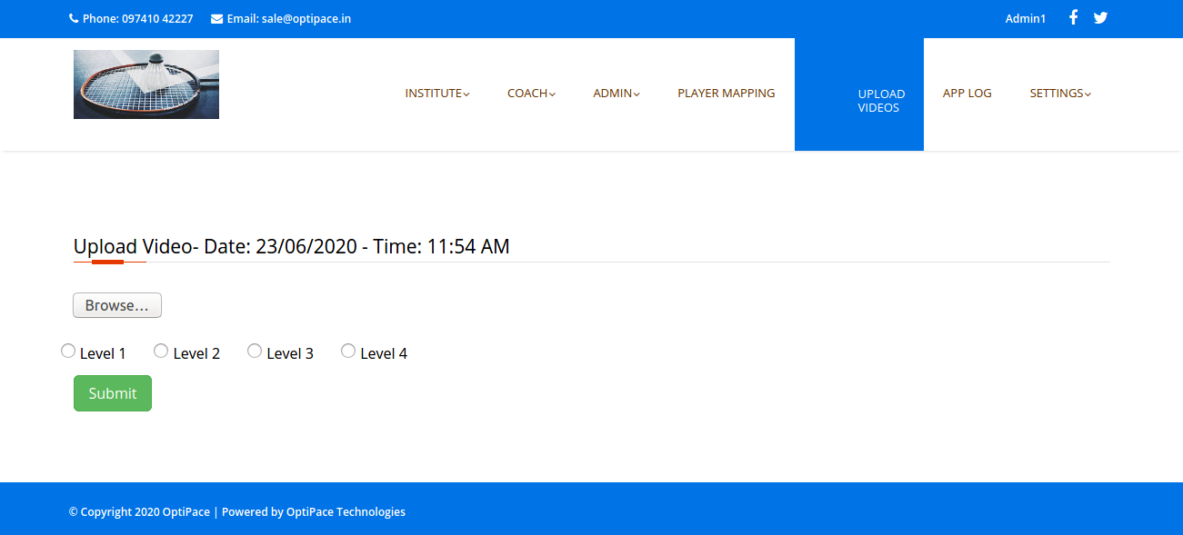
Uploading Videos to server for playing game

Slide 13
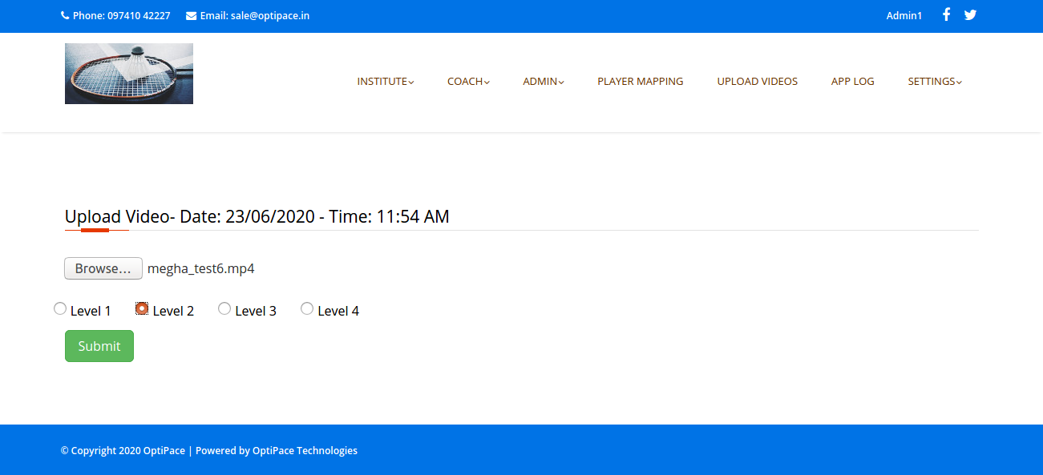
After Selecting Video from Local system, Select level for which video need to be uploaded
After uploading the video, it is necessary to add pauses else the “Play Game” module wont work!!

Slide 14
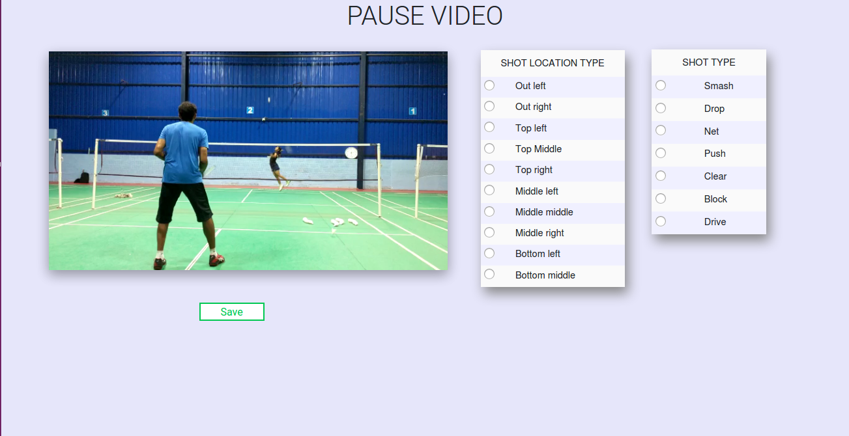
After Clicking submit button from slide 13 redirects to Pause page

Slide 15
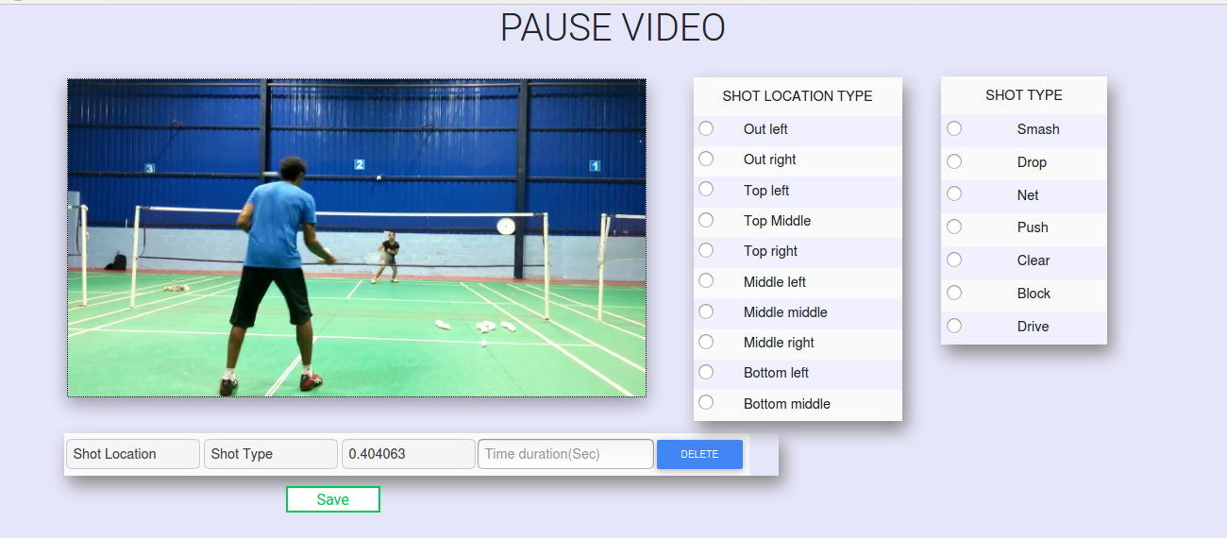
Admin needs to play the video and pause the video by clicking on video. When admin pauses the video, a table structure appears where admin needs to select shot location, shot type and enter time duration[Time taken for player to answer]. The time duration should be in seconds format.

Slide 16
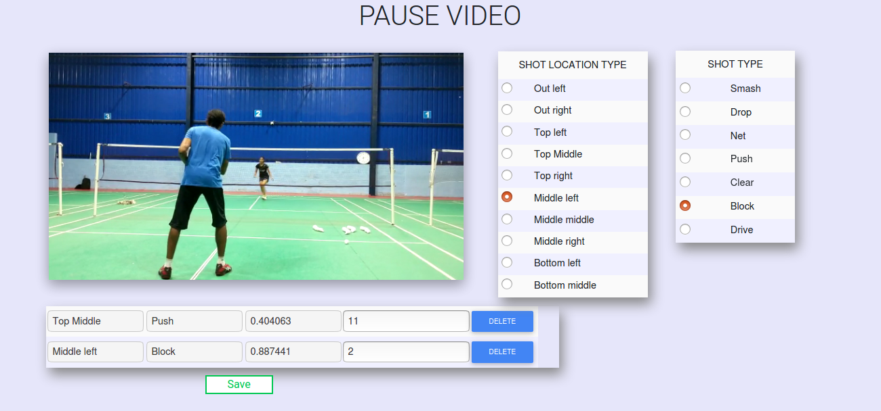
Once Admin selects Shot location, shot type and enter time duration. Admin needs to manually resume play video by clicking play button or by ckicking on video frame .

Slide 17
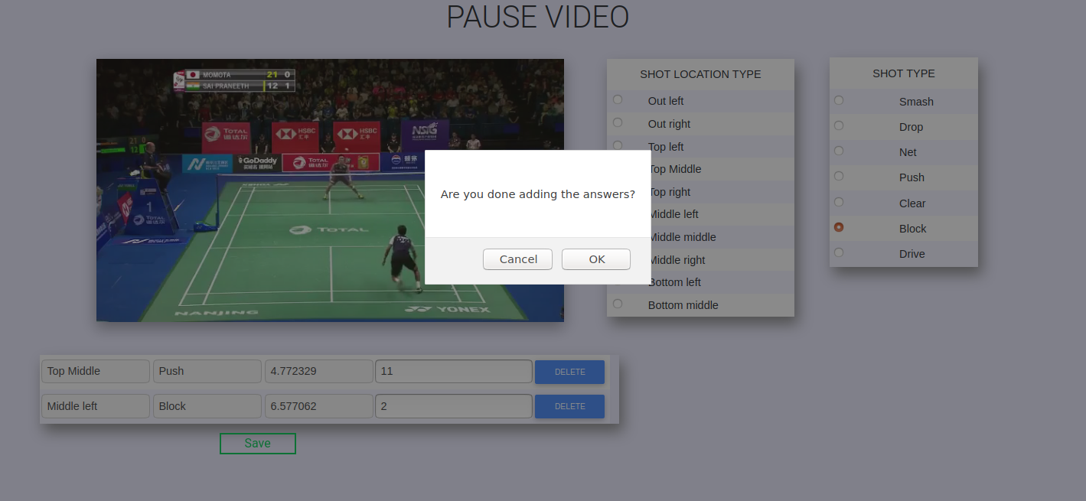
Admin needs to click save button , which asks for the confirmation before you save answers for the video. On clicking OK, the answers are saved

Slide 18
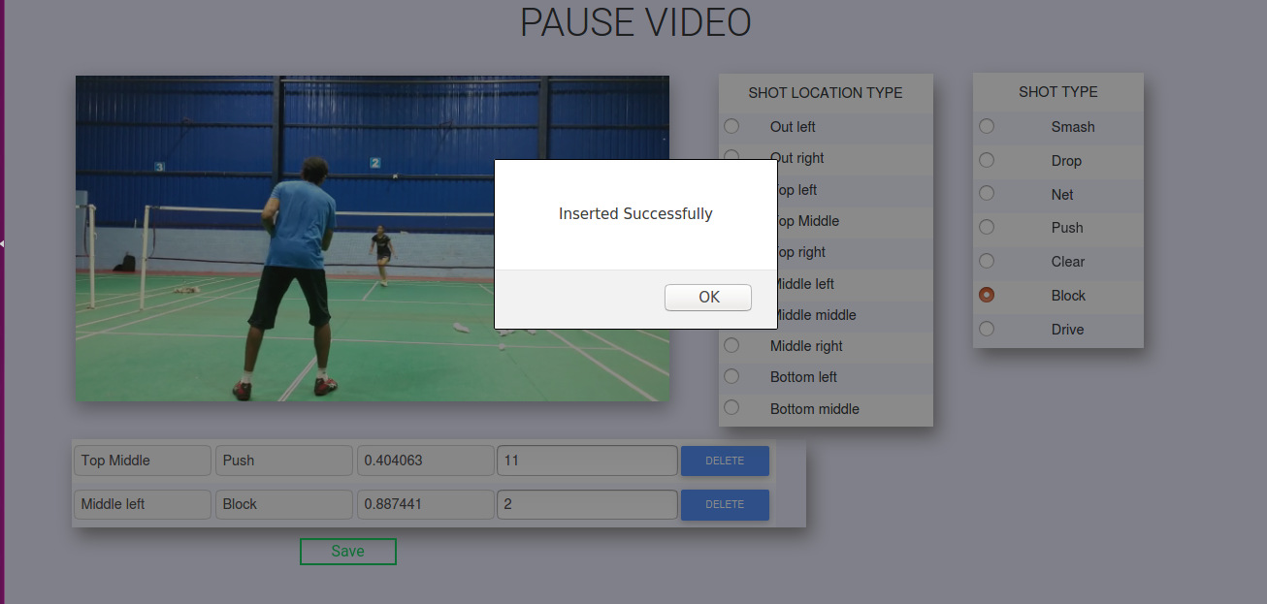
Answers saved successfully

Slide 19
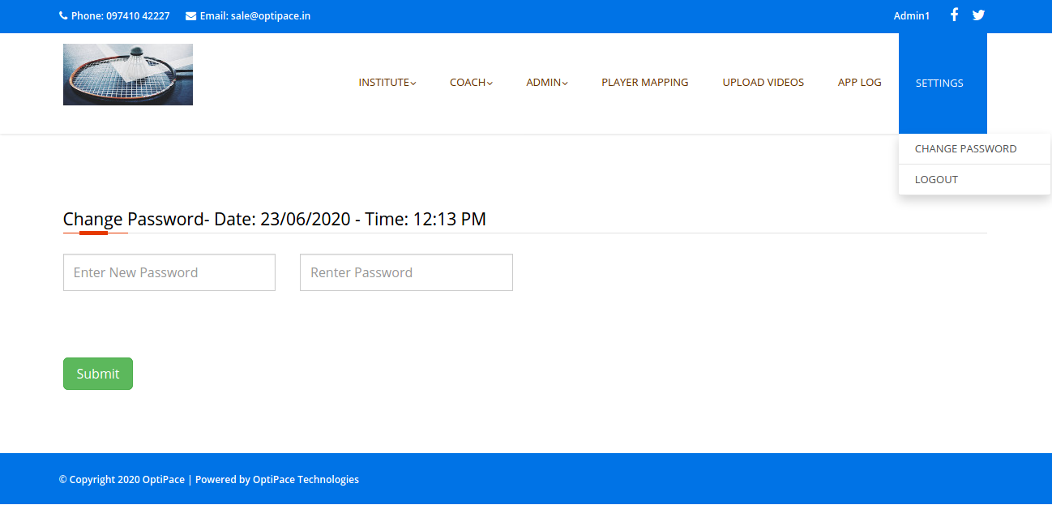
Change Password for admin

Slide 20
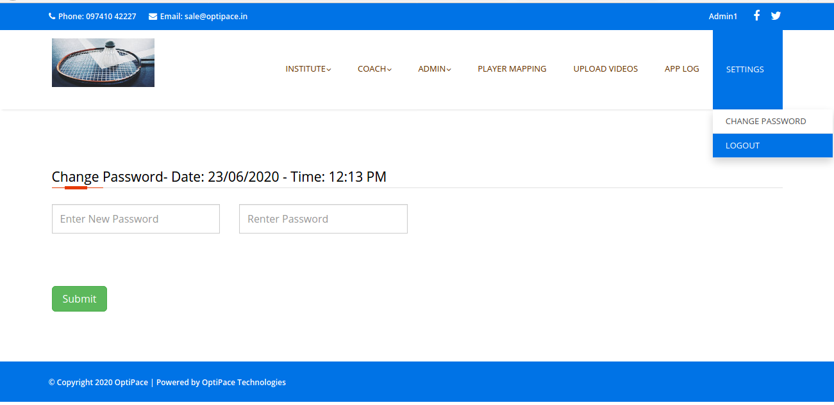
Click Logout button to logout from server app

